Slide 1
Implementing Community Suicide Protocol
Susan Armstrong, M.Ed. R.C.C.
Prince George, BC

Slide 2
NECESSARY STEPS
Write protocol & assessment forms
Identify one co-ordinator
Invite all community stakeholders
Obtain commitment on protocol
Train on protocol and suicide assessment
Arrange debriefing meetings with involved stakeholders when protocol implemented
Annual protocol meetings/trainings required

Slide 3
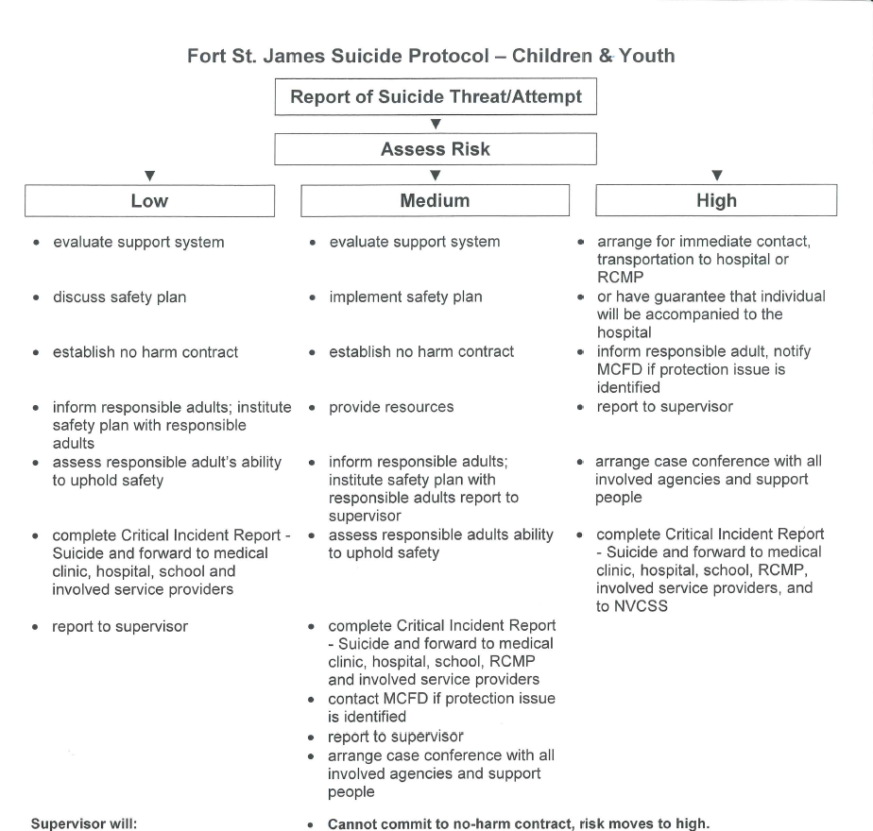

Slide 5
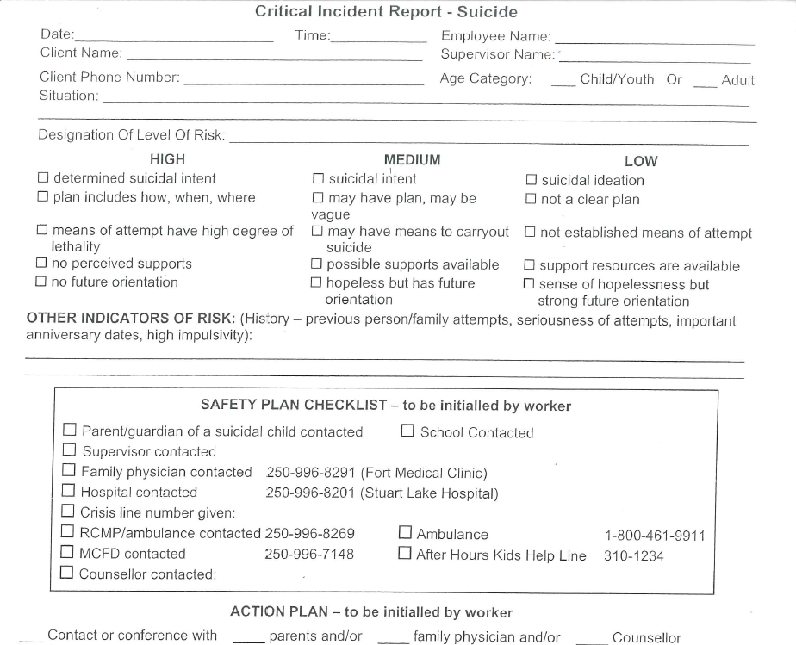

Slide 6
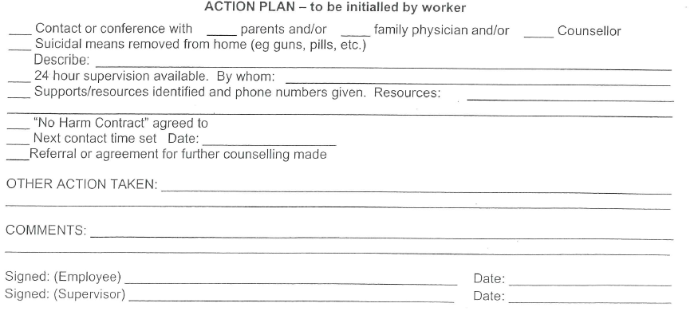

Slide 7
RISK LEVELS OF SUICIDE
WHAT TO DO
HIGH
* suicide intent * implement community’s suicide protocol
* has plan and lethal means
* no perceived supports * contact emergency, family doctor etc.

Slide 8
Splats’in Suicide Protocol
HIGH RISK
ARRANGE FOR IMMEDIATE CONTACT OF PSYCHIATRIC EMERGENCY RESPONSE TEAM OR RCMP
OR HAVE GUARANTEE THAT INDIVIDUAL WILL BE ACCOMPANIED TO THE HOSPITAL
REPORT TO HEALTH DIRECTOR BY NEXT BUSINESS DAY
IF YOUTH INFORM CAREGIVERS
CONTACT CHILD WELFARE IF PROTECTION ISSUE IS IDENTIFIED

Slide 9
MEDIUM RISK WHAT TO DO
* indicated suicide intent *clear communication
* obtain commitment to
* may have plan not harm (contract)
* report to doctor, caregivers
* perceived support * follow up counselling supports
* may have investment in
immediate future

Slide 10
LOW RISK WHAT TO DO
* suicide ideation * communicate caring & explore issues
*does not have clear plan
or means
* evaluate supports
* feels hopeless, helpless
but has supports in place
that they recognize * report to caregivers
* follow up counselling supports

Slide 11
One Day Community Training
Defining terms used regarding suicide
Ways of understanding suicide
Incidence rates
Suicide Risks (high – medium – low)
Community Protocol
Risk Assessments
No Harm Contracts
Safety Planning

