Slide 1
Gathering Strength Initiative
“What we have done,
What were doing and
What were going to do” Our Inspiration ^^^^....The Men Of Saanich No.5

Slide 2
The HUB
South Island HUB is about Planning, Collaboration and Communication. Partnership is essential

Slide 3
Gathering Strength LOGO ☺

Slide 4
About Our Logo
The Gathering Strength team is thankful to Master artist Perry Lafortune of WSANEC for his donation to the organisation and cause.
The Beautifully crafted WSANEC Guardian protects the House of the WIL,NEW people. We are both indebted and honoured to our guardians, yet understand our role to help our families during their time of need.

Slide 5
Niagra Falls 2012
Gathering Strength Team at CASP 2012

Slide 6
Our strength is still building.
We have every intention of carrying on the work of our ancestors with this vitally important work for the people of WSANEC.
Our Goals are to contribute to the physical, mental, emotional and spiritual health and wellness of our communities in a holistic way and in a culturally sensitive manner.
There is ALWAYS something to learn, there is ALWAYS opportunity to contribute.

Slide 7
Our losses-Suicide Prevention and awareness
Each of us has experienced extremely difficult life changing losses that we chose to use as inspiration and a source of healing.
“one is too many’
‘One and done’ approach isn`t the way
Support will be limited and opposition will be common. ``Those not for us, are usually against us.....``WLM april 2012
Unity and collaboration is needed to achieve success.

Slide 8
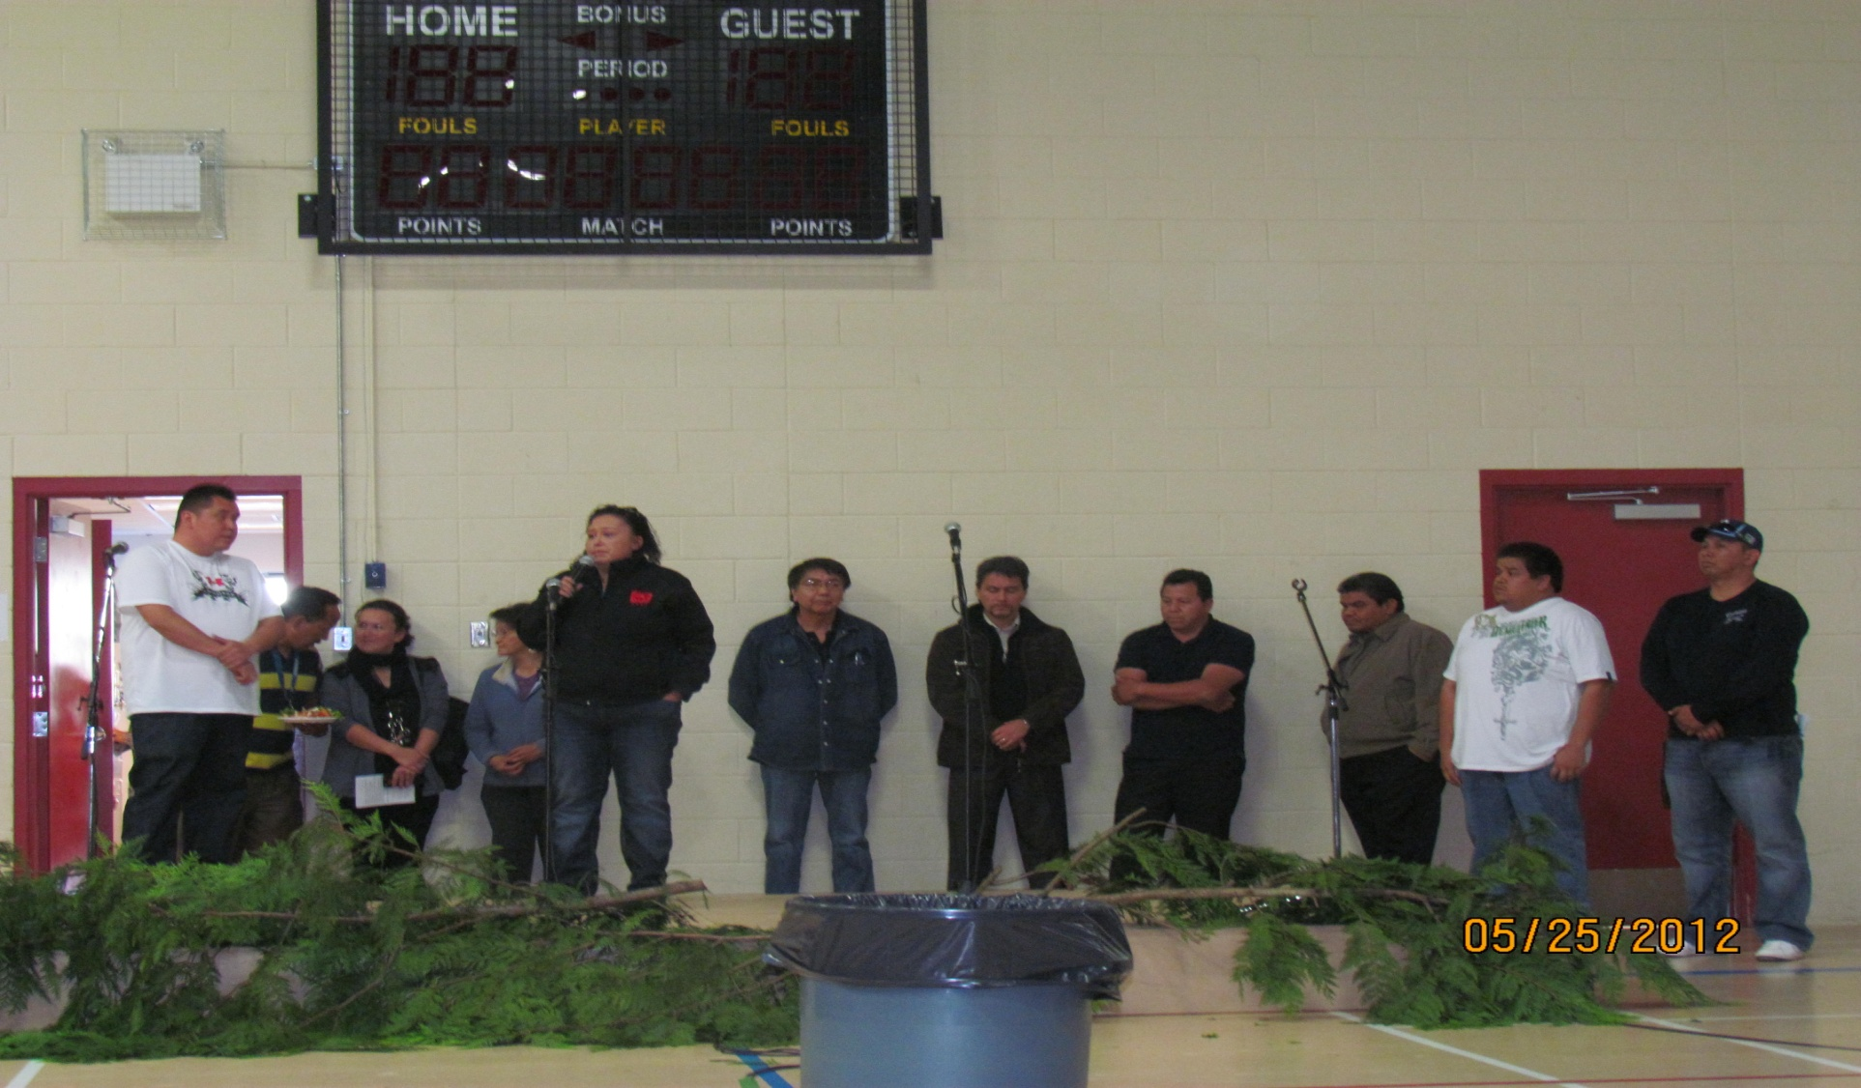
Our successes-”What We have done”
The Community dinner- May 2012 Annual Event

Slide 9
Our challenges for the event
Money
Timing
Strength
Support
Guidance
Traditional Belief
Capacity
Political unity

Slide 10
What We have done-Media Attention-CTV
http://
www.youtube.com/watch?v=uekTzeuiox4
YouTube

Slide 11
Our successes, lessons.
Suicide Idealogy training with Bev Williams: June 2012 XX participants
The Gathering Strength Police day- July 2012
XXX participants
Moving from hopelessness to power training with Shane Baker July 2012-XXX Participants
ASIST Training July- September 2012. XX WSANEC Participants
CASP 2012 “coming out of the darkness” National Conference in Niagara Falls. October 2012
Gathering Strength Presentation at Brock University in Ontario October 2012

Slide 12
Our Successes Cont’d
Our Invitation to present Gathering Strength at the next CASP Conference in Winnipeg Manitoba 2013
Our invitation to present our ideas to SNUNEYMUX First Nation
Our invitation to present to the UBC Learning Circle December 2012. –Health Canada.
The Bracelet sales ongoing and successful.
Brock University – Presentation on HUB and Gathering Strength.

Slide 13
What were doing now
Gathering Strength / Eli Pasquali Basketball Camp open to all WSANEC Youth.
Gathering Strength Boxing Camp
Gathering Strength Swim Camp
Gathering Strength/WSANEC United Soccer Camp.
ASIST Training- more training TBA.
Establishing a “trauma team” of all known ASIST Trained community members in WSANEC.

Slide 14
One of our ideas

Slide 15
More plans

Slide 16
More Ideas In Action

Slide 17
How can we help you??
Our ancestors are amazing men and women. We just want to try and live up to their expectations.

Slide 18
Our Hopes

Slide 19
Our strength
Mary Spencer- Aboriginal Boxer

Slide 20
Our Dreams

Slide 21
Our passion
Christine Sinclair of Olympic Team Canada

Slide 22
Its up to you
Carey Price of the Montreal Canadians.

Slide 23
The Road to N.a.i.g.
Camps, Leagues, Training Facilities and programs, WSANEC Games, Coast Salish Games, NAIG Qualifying........National Representation.

Slide 24
Whats Coming
Gathering Strength Youth Conference
Spring 2013

Slide 25
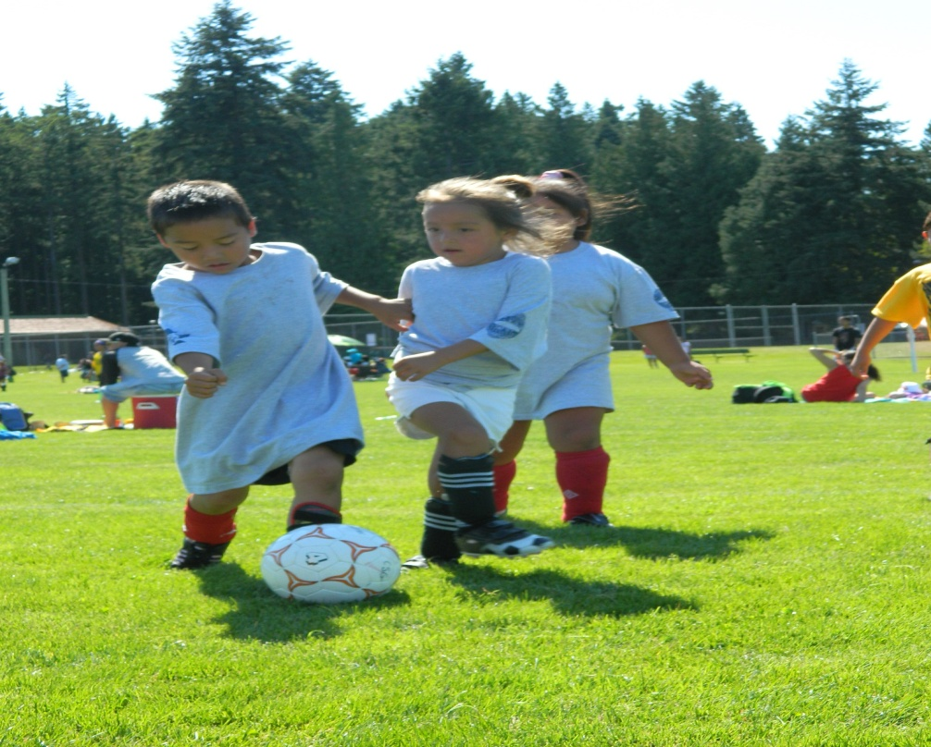
Gathering Strength WSANEC Games

Slide 26
Lacrosse with the 6 nations
We made a partnership with 6 Nations Lacrosse Dreamcatcher foundation that will see Elite level players as coaches in WSANEC in the spring on 2013.

Slide 27
A Gathering Strength APP
A useful Iphone application for people in difficult situations.
A source of information about the happenings of the Gathering Strength Initiative

Slide 28
Trauma outreach team
There are more than 20 WSANEC people that have the ASIST Training.

Slide 29
athlete recognition dinner
We have many successful athletes in WSANEC, We would like to recognise these elite level athletes and coaches for their hard work and dedication.

Slide 30
Asist training
Further ASIST Training will be provided

Slide 31
Presentations winnipeg

Slide 32
Interactive workshop
Our course
Build awareness in our youth populations

Slide 33
Youth Group Creation
Gathering Strength Youth Group

Slide 34
Our Camp demographics
Service approx 110 Saanich people
Youngest 5 yrs – Oldest 45??
There are still sports coming and other activities
There are entire groups of people that we are still leaving out.
Were doing well but what about the young adult, adult, senior, and elders groups that must be addressed.
We must not discriminate and we have to thrive to be better.

Slide 35
We need a list of places to present
VNFC
Hosp staff
VIHA
Health Canada
All Tribes
All Sports clubs
All Mens and Ladies groups
WSANEC school board!!

Slide 36
Partners
We are collaboration at its finest
Our success rate is.......pretty good
We thank:
NIL,TUO
Tsawout, Tsartlip, Tseycum, Pauquachin
SNSP
Sidney RCMP
VIHA
And many more!!

Slide 37
We have not yet had an evaluation!!
If we wanna improve...how are we going to do this? Try harder? Lol
I would love an impartial party to evaluate our team and our individual strengths and weaknesses!!

Slide 38
Suggestions?
We are community driven and community based.
This program is for the use and benefit for all of us so Suggestions are welcome

Slide 39
Shhhhhh...... :-)
Gun Safety Day
In partnership with Sidney RCMP, Central Saanich Police, Gathering Strength and DND?

