Slide 1
Nenqayni Wellness Centre Society
Statement of Purpose:
Provide holistic healing to First Nations and Inuit youth, families, and communities in a safe and secure environment.
www.nenqayni.com

Slide 2
Presentation Outline
A Brief History
Treatment Centre Governance, Operations, and Service Delivery
Nenqayni Programs
Family Alcohol and Drug Program (FADP)
Youth and Family Inhalant Program (YFIP)
Nenqayni Community Mobile Program
Continuing Care Program
Accreditation

Slide 3
A Brief History
The Nenqayni Wellness Centre began treatment services in 1981 after several years of struggle and hard work by many concerned people of the Cariboo-Chilcotin.
Nenqayni first provided services out of the old residential school (St. Joseph’s Mission), moving to the Slumber Lodge Motel and finally moving to its own newly built facility on the Deep Creek reserve.

Slide 4
A Brief History
In July 1996 Nenqayni was one of the first youth treatment programs nationally to admit youth clients into the new Youth & Family Inhalant Program. Originally located in modular trailers, the Youth Program moved to a new building in 2002.

Slide 5
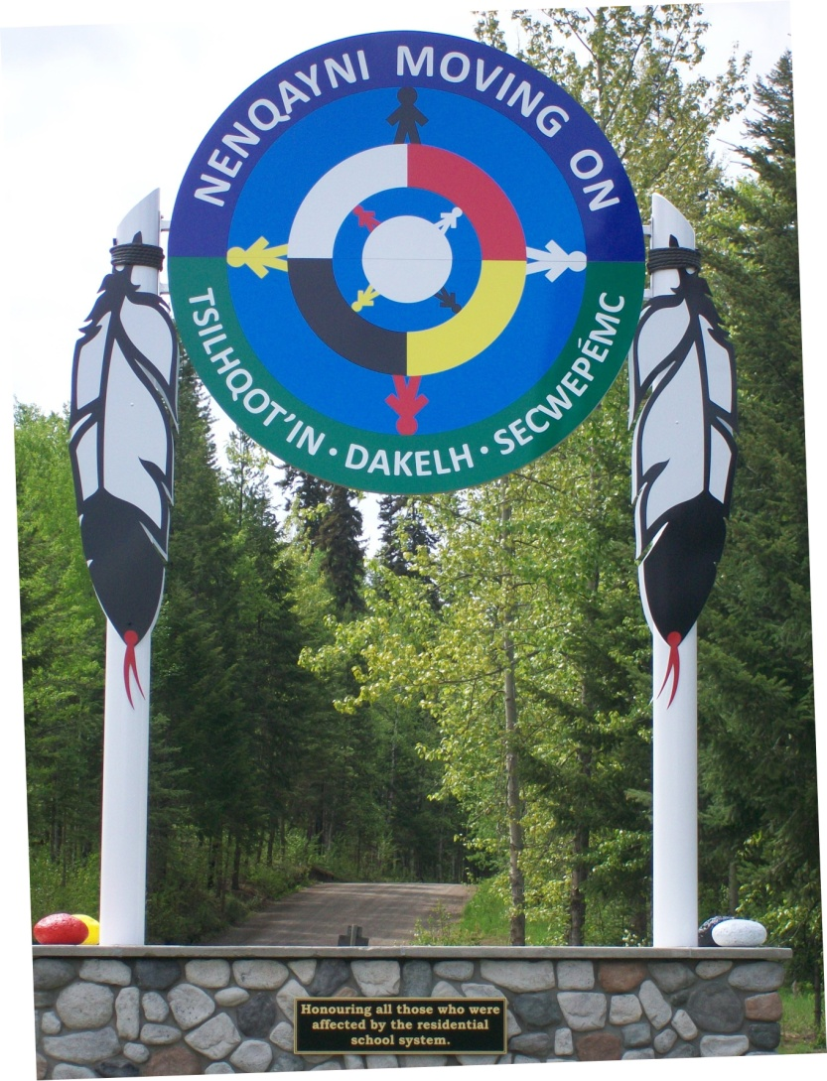
A Brief History
In subsequent years, a full size gym, a new daycare and family program school (2008) named the Antoine Archie Education Centre were built greatly enhancing the services available to clients in both programs.

Slide 6
Treatment Centre Governance
Nenqayni is a non-profit society owned by the 15 bands and 3 Nations in the Cariboo Chilcotin
Nenqayni’s Board of Directors is comprised of 2 representatives from each Nation

Slide 7
Treatment Centre Governance Our15 Bands
6 Tsilhqot'in (Chilcotin) Nations
Toosey, Nemiah Valley, Stoney, Red Stone, Anaham, Alexandria
5 Secwepemc (Shuswap) Nations
Alkali Lake, Soda Creek, Williams Lake, Canoe Creek/Dog Creek, Camin Lake
4 Dakelh (Carrier) Nations
Kluskus, Redbluff, Nazko, Ulkatcho
See Map of our service area

Slide 9
Treatment Centre's Supports: A.B.C.F.N.T.P.
Association of British Columbia First Nations Treatment Programs
Mission: “To provide a First Nations forum that promotes culturally relevant best practices to enhance, excel and advance the continuum of care in addressing addictions”

Slide 10
Treatment Centre Operations: Staffing
Clinical staff are certified by the Canadian Council of Professional Certification and receive ongoing training relating to their positions and as required by accreditation and licensing.
All staff must: meet minimum training requirements, have 3 years sober living, clean criminal record check, drivers abstract check, ethics and confidentiality requirements.

Slide 11
Treatment Centre Operations: Staff Training
All of Nenqayni’s staff receive regular training in the following areas:
Medication Administration
Self Harm Awareness and Intervention
Applied Suicide Intervention Skills
Non-Violent Crisis Intervention
Data and Outcome Collection
Aboriginal/Cross Cultural Awareness
First Aid
Current Mental Health
Resiliency
AND MUCH, MUCH MORE!

Slide 12
Service Delivery: Intake
All clients attending Nenqayni’s residential programs must complete an intake package.
Intake packages can be found on the Nenqayni website (www.nenqayni.com) or by contacting Nenqayni (250-989-0301) and speaking to our intake coordinators.
Youth Program: Sharon Duffy ext. 223
Family Program: Joan Evans ext. 206

Slide 13
Acceptance: Basic Requirements
Most treatment centers require similar basic requirements for clients to be eligible for intake. These include:
Medical screening
6 counseling sessions
Tuberculosis test
Detox completed (if required)

Slide 14
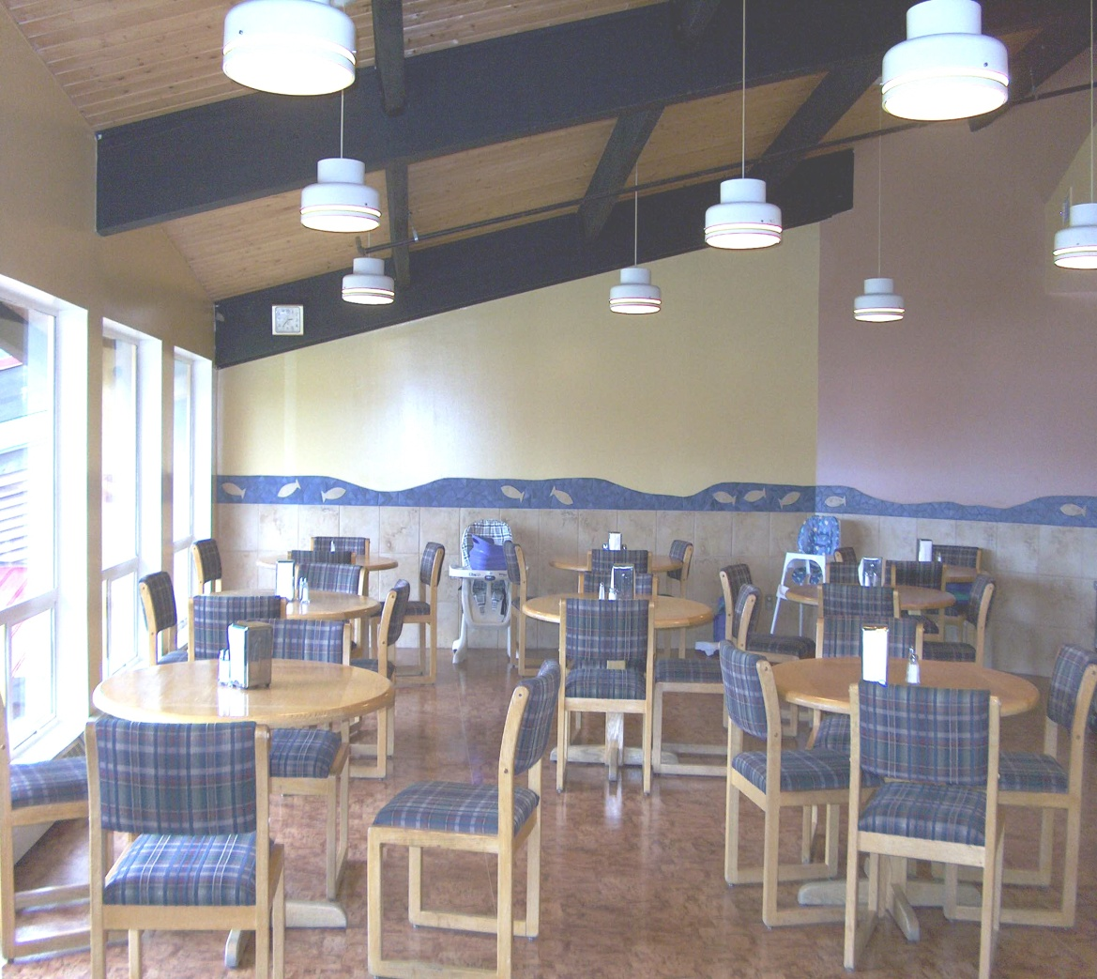
Service Delivery: Therapeutic Community
Nenqayni provides lunch and dinner Monday – Friday
Youth and family programs and staff eat together

Slide 15
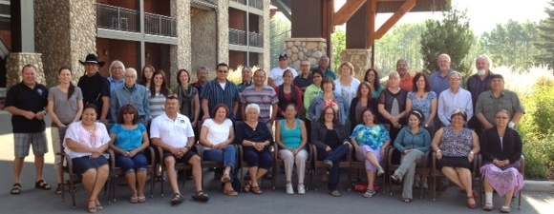
Service Delivery: Culture is Healing
Nenqayni believes that First Nations traditions and culture are important parts of healing for First Nations people.
Nenqayni is participating as both a NNADAP Centre and YSAC Centre in the “Culture as Interventions Research Project” (CasI)
www.tinyurl.com/cultureasintervention

Slide 16
The Aims of the CasI Project
to improve and promote the health of First Nations who problematically use substances through innovative health intervention research;
to document and generate knowledge on indicators of the impact of Indigenous cultural interventions on client wellness;
to design a culturally valid instrument to measure change in client wellness;
to disseminate the research findings and implement knowledge translation strategies within the national NNADAP and YSAP treatment system, and specifically inform the development of the national addictions data management system;
to provide a successful model of collaborative Indigenous health intervention research that is rooted in research being conducted by, for, and in balance with First Nations health stakeholders; and
to facilitate mentoring opportunities among the diversity of partners involved in the study.

Slide 17
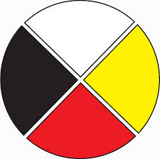
Culture at Nenqayni
Staff and clients begin the day with drumming and sage and prayer.
Staff and clients participate in sweats, pipe ceremonies, drum making, medicine gathering, drumming and singing.
Consistently, feedback from clients reports cultural and ceremonial activities as some of the most beneficial and enjoyable activities at the centre.

Slide 18
Service Delivery: Outings and Activities
Both the Family Program and Youth Program enjoy a variety of outings and activities:
AA and NA
Round Ups
Powwows
Crafts – beading, finger painting, rattles
Medicine Gathering and Sage Picking
Swimming, Bowling, Hiking, Historical Sites

Slide 19
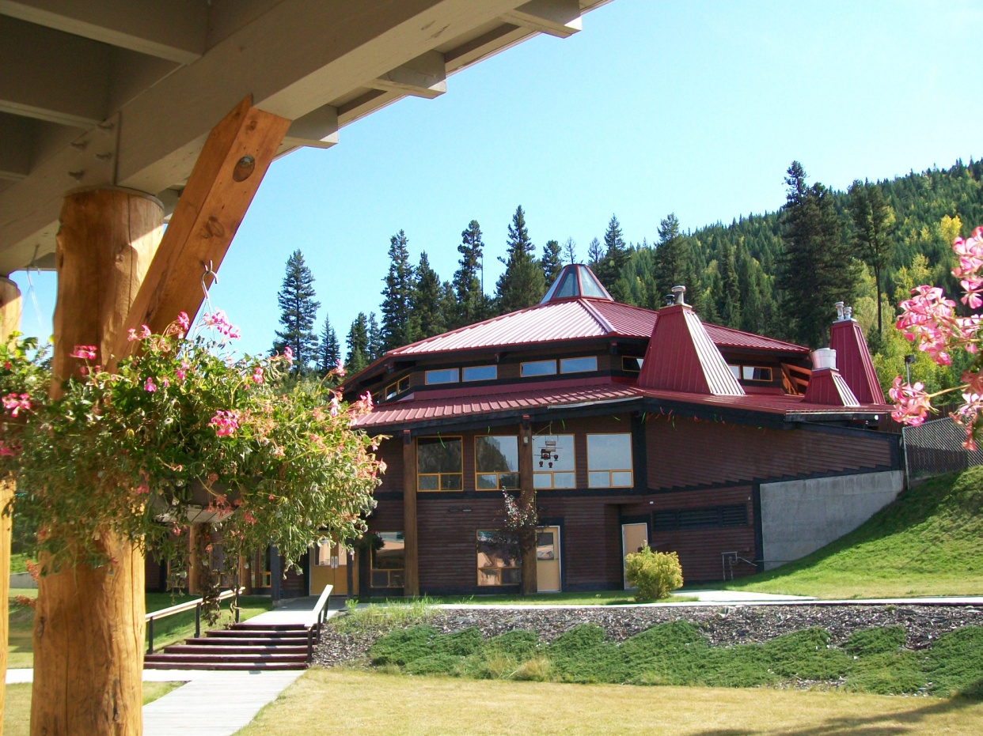
Family Alcohol and Drug Program An eight week culturally based residential program that focuses on both the individual and the family unit in the treatment of addiction.

Slide 20
National Native Alcohol and Drug Abuse Program (NNADAP)
Nenqayni family program is a NNADAP treatment centre.
NNADAP is the primary network in place to respond to First Nations substance use issues.
49 NNADAP alcohol and drug abuse treatment centres across Canada
NNADAP Renewal Framework: http://nnadaprenewal.ca/wp-content/uploads/2012/01/Honouring-Our-Strengths-2011_Eng1.pdf

Slide 21
Programming
Cohesive Groups
Single mothers, dual parents
Program is dynamic and fluid
Groups needs determine what is presented
All themes of programming carry throughout
Group sessions act in conjunction with afternoon and weekend workshops and activities

Slide 22
Program Counselors and Coaches
Full time youth counselor for children in the families
2 full time elders
Male and female counselors for group sessions and individual sessions
Coaching staff to facilitate workshops and activities

Slide 23
Workshops
Stages of Change
Parenting
Medicine Wheel – Balance
Communication
Anger Management
Grief and Loss
Family/Domestic Violence
Historical Trauma
Sexual Health

Slide 24
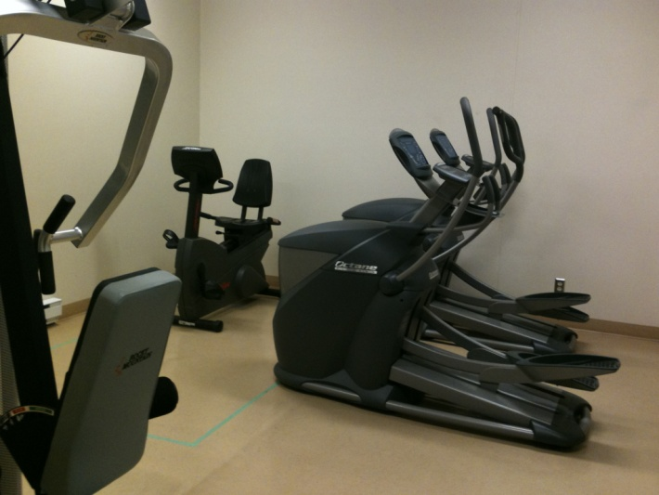
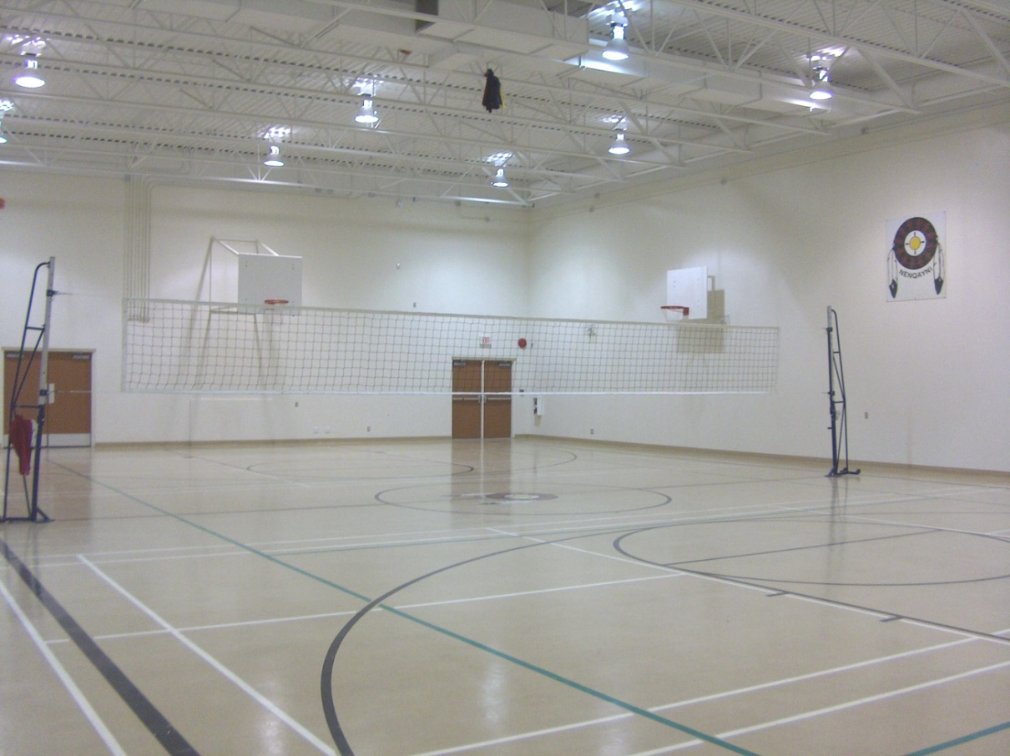
Recreational Programming
Nenqayni gymnasium
Nenqayni cardio and weight room

Slide 25
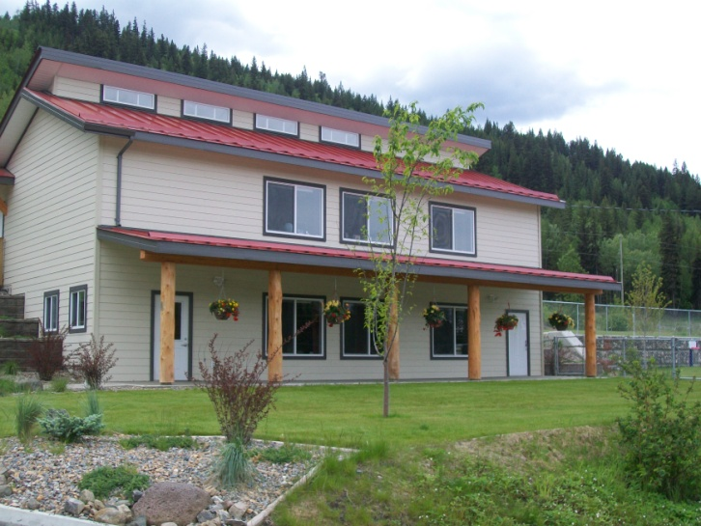
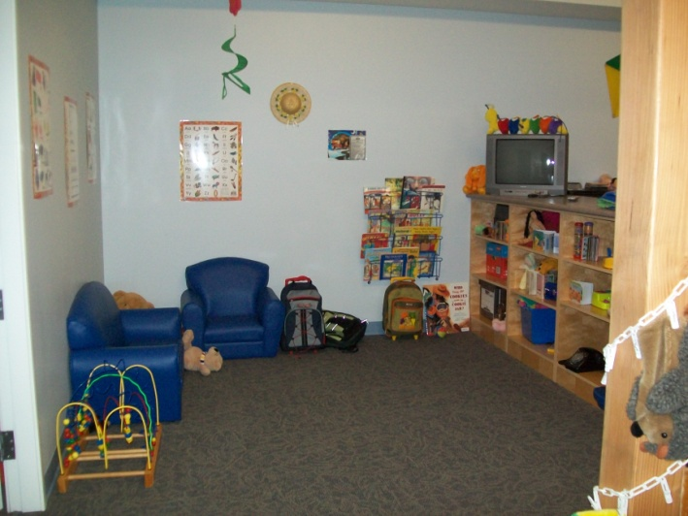
Child Care
Nenqayni provides daycare for children newborn to 4 yrs old.
Nenqayni also provides evening babysitting during adult program time.

Slide 26
Family Dynamics
How to be a sober family
Codependence
Feelings of guilt or abandonment
Feelings of jealousy and mistrust
Restructuring the family dynamic
Forming familial attachments

Slide 27
Questions about Nenqayni's Family Program?

Slide 28
Youth and Family Inhalant Program

Slide 29
Youth Solvent Abuse Committee
Nenqayni belongs to a national committee of youth treatment centers from across Canada called YSAC (www.ysac.info)
Vision: “Delivering pro active, social, cultural and evidenced based programs that empower Indigenous families and communities to improve their quality of life.”

Slide 30
The YSAC Mandate is:
To strengthen our Indigenous Recovery Network of substance abuse Treatment Centres for youth, their families and communities;
To provide services based on indigenous principles and values;
To utilize and respect the natural value of culturally based programming;
To develop and share Best Practice initiatives with members and partner organizations, nationally and internationally;
To ensure a national perspective is considered in conjunction with attention to and respect for regional and centre based priorities and projects.

Slide 31
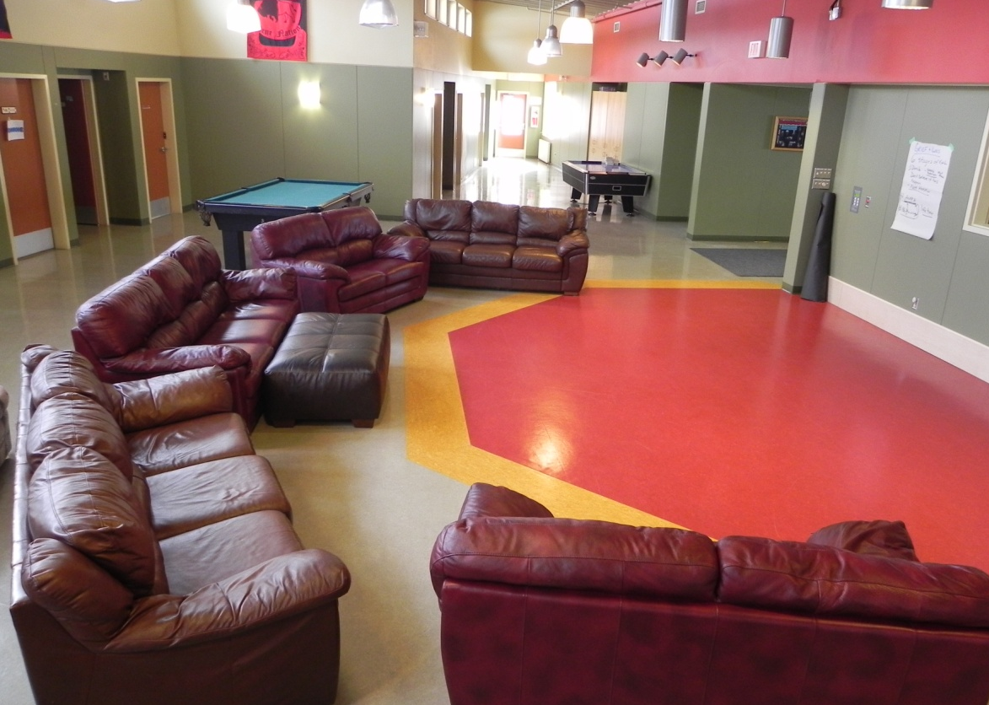
Youth and Family Inhalant Program
The Youth Program has 3 intakes per year. They occur in January, mid May and late August. Each treatment cycle is approximately four months in length.
Although the youth program is called an “Inhalant Program”, Nenqayni accepts youth from all over Canada who struggle with substance abuse and/or substance abuse affected life styles – not only inhalants.

Slide 32
Youth and Family Inhalant Program
The youth program includes school, education sessions, group sessions, individual counseling, a focus on fitness, nutrition awareness.
Cultural activities such as daily smudging, sweats, and drumming and singing.
Youth also enjoy hand crafts and art activities such as beading, painting, sewing, etc.

Slide 33
Work Shops
Self Esteem
Emotional Intelligence
Medicine Wheel – Balance
Communication
Bullying
Anger Management
Grief and Loss
Family/Domestic Violence
Historical Trauma
Sexual Health
Drug of abuse info sessions: crystal meth, cocaine, marijuana, crack
AND SO MUCH MORE!

Slide 34
Questions about Nenqayni's Youth Program?

Slide 35
Nenqayni Mobile Treatment Program

Slide 36
Mobile Treatment Program
Began in the fall of 2012
Funding from the Interior Health Authority, First Nations Health Authority and Health Canada
Delivers “mobile” (i.e. outreach or day programming) to the 15 bands that own and govern Nenqayni Wellness Centre.
3 week long programs delivered at the community level that are designed to be community driven and Nation based.

Slide 37
Mobile Treatment Program
Schedule and interventions for each community program are developed by completing a needs assessment with community members, elders, band staff, councils and chiefs.
Nenqayni provides staff best able to meet the needs of the community.
Staff stay within the community and deliver programming at times which best suit the attendees.

Slide 38
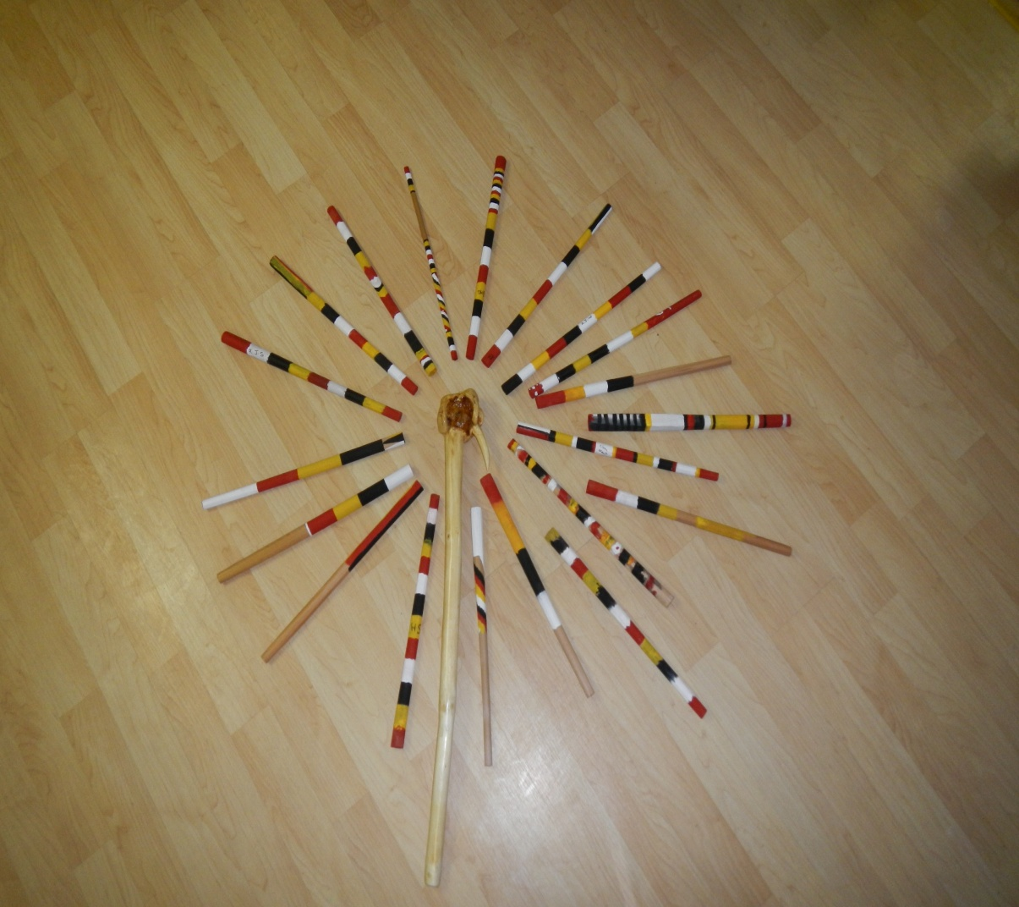
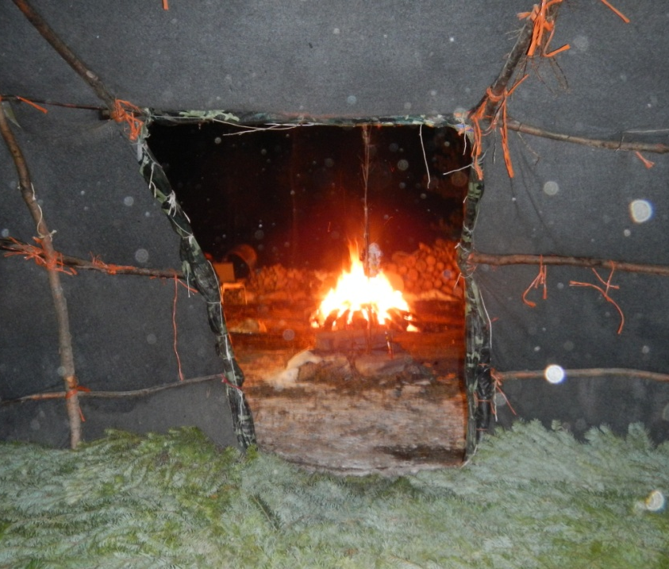
Mobile Treatment Program
Nenqayni collects basic information from participants to start and there are none of the usual requirements for attending residential treatment programs.

Slide 39
Mobile Treatment Program
Accessibility is key and is partly responsible for the enormous success of this new program.
No medical, no testing, no sober time, no previous visits
An open door policy
Culture and traditional activities are reported as some of the program’s best features.
97% of participants over 7 communities stated that they would like the program to return

Slide 40
Questions about Nenqayni's Mobile Program?

Slide 41
Continuing Care Program

Slide 42
Continuing Care Program
Nenqayni Wellness Centre undertook an extensive research project in the area of continuing care in 2007.
The research conclusions and resulting recommendations addressed the needs of community workers and volunteers, focused on continuing care as a community-based service, outreach for communities, training for workers, communication, continuing care planning, culture and spirituality.

Slide 43
Continuing Care Program: Continuing Care is a full time job!
Nenqayni recognizes that treatment is not completed when a client graduates from one of our programs and that treatment is an ongoing process consisting of community supports / services as well as continued support from our centre after our clients leave.

Slide 44
Continuing Care Program
With time, commitment and the collaborative efforts of staff Nenqayni has developed and implemented a system that nurtures the importance of building relationships with our clients while they are with us and is sustained over a period of time for continuing support.

Slide 45
Continuing Care Program
Nenqayni recognizes technological advancements of today’s world and the impact of social media.
We have implemented a variety of contact options and continue to review options so that Nenqayni can provide the best services possible to persons who attend the program. Today we make available the toll free number (see above), snail mail, fax, texting, video conferencing, and Facebook (closed group for past clients only).

Slide 46
Continuing Care Program
Our system provides a schedule to assist with regular contact with past clients from the Family, Youth and Mobile Programs.
Past clients may seek help / guidance by accessing our Continuing Care services pre and post treatment by calling the toll free number 1-888-668-4245.

Slide 47
Questions About Nenqayni's Continuing Care Program?

Slide 48
Nenqayni is Accredited!

Slide 49
Accreditation
In 2001, Nenqayni Wellness Centre was accredited by the Canadian Council for Health Services Accreditation (CCHSA) - now called Accreditation Canada (AC).
In 2010 Nenqayni Wellness Centre moved to the Canadian Accreditation Council (CAC).

Slide 50
Accreditation
It’s not easy, but it is worth it!
Accreditation assists in important areas of growth, promoting positive changes that support improved services for all clients and also a healthy environment for staff and the organization’s partners.

Slide 51
Positives of Accreditation Within Nenqayni
More organized and consistent
Increased communication across all staff and shifts
Increased awareness of job requirements
Increase safety for staff and clients
Enhances credibility of our programs
Focused trainings for all staff that are regularly renewed and maintained

Slide 52
An Invitation to Professionals and Referral Workers
If you have never been to the centre and are curious about what it really looks like (even website pictures cannot do it justice) we offer onsite tours if you stop by. By calling ahead we can tailor the information to your needs. Some areas may not be open access due to respecting the privacy of persons currently attending the programs.
1-888-668-4245

Slide 53
Last Chance! Any Questions?

